Slide 1
Lecture 1 – Internet Security or AKA Why do we need to study this…
COM744: Security and Risk Management
Nigel Houlden / Denise Oram
n.houlden@glyndwr.ac.uk / d.oram@Glyndwr.ac.uk

Slide 2
INTERNET SECURITY THREAT REPORT
Symantec February 2019 - VOLUME 24
https://www.symantec.com/security-center/threat-report

Slide 3
Big Numbers
One in Ten URLS are Malicious
Web Attacks up 56%
4,800 – Average number of Websites compromised with formjacking each month
Supply Chain attacks up 78%

Slide 4
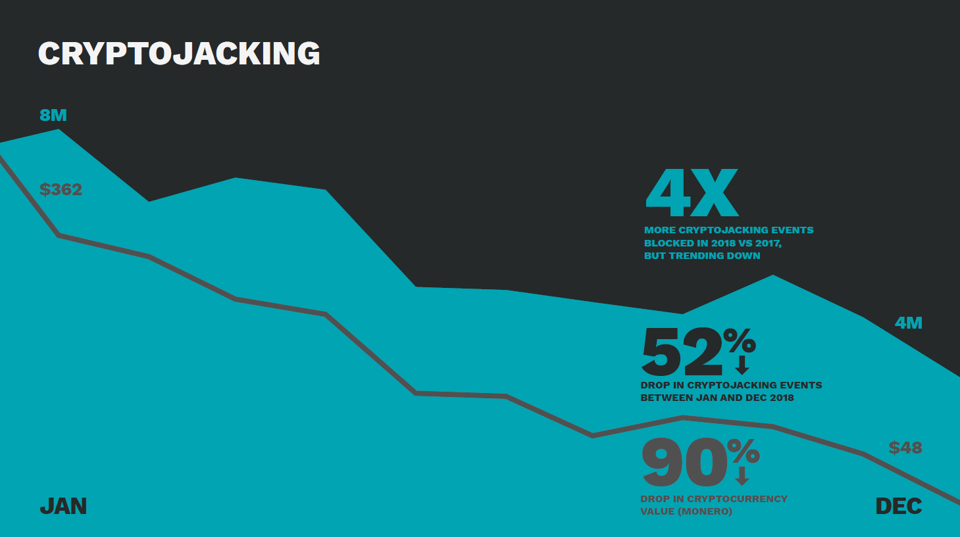

Slide 5
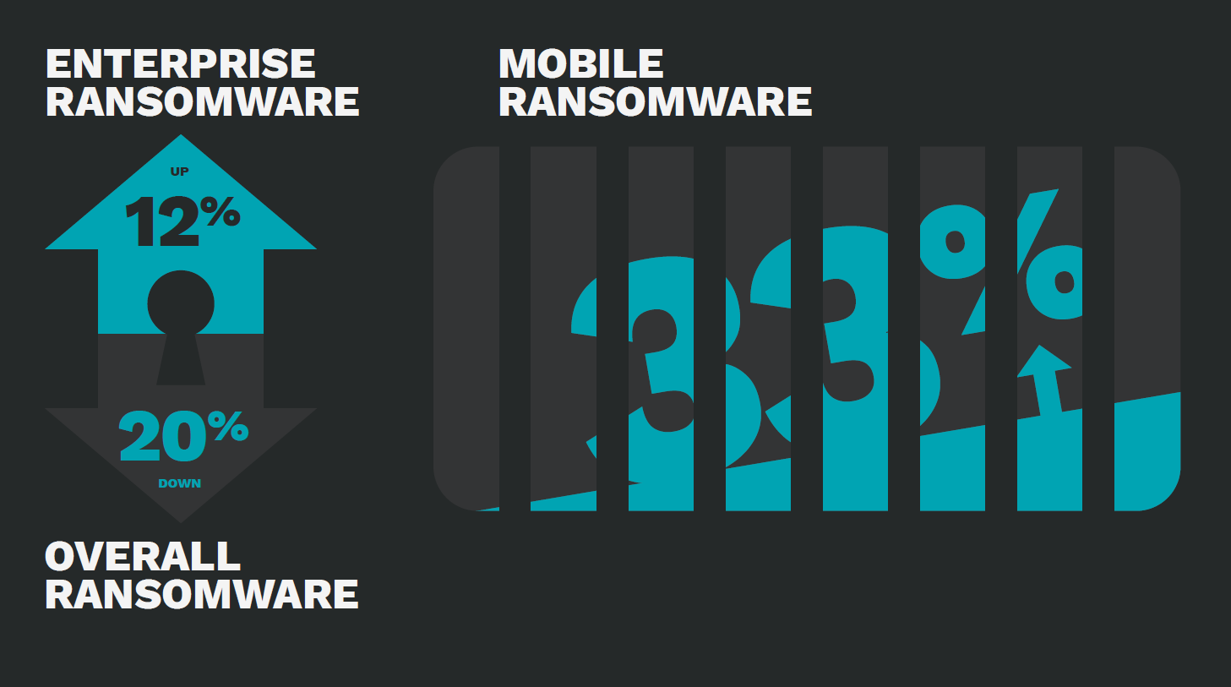

Slide 6
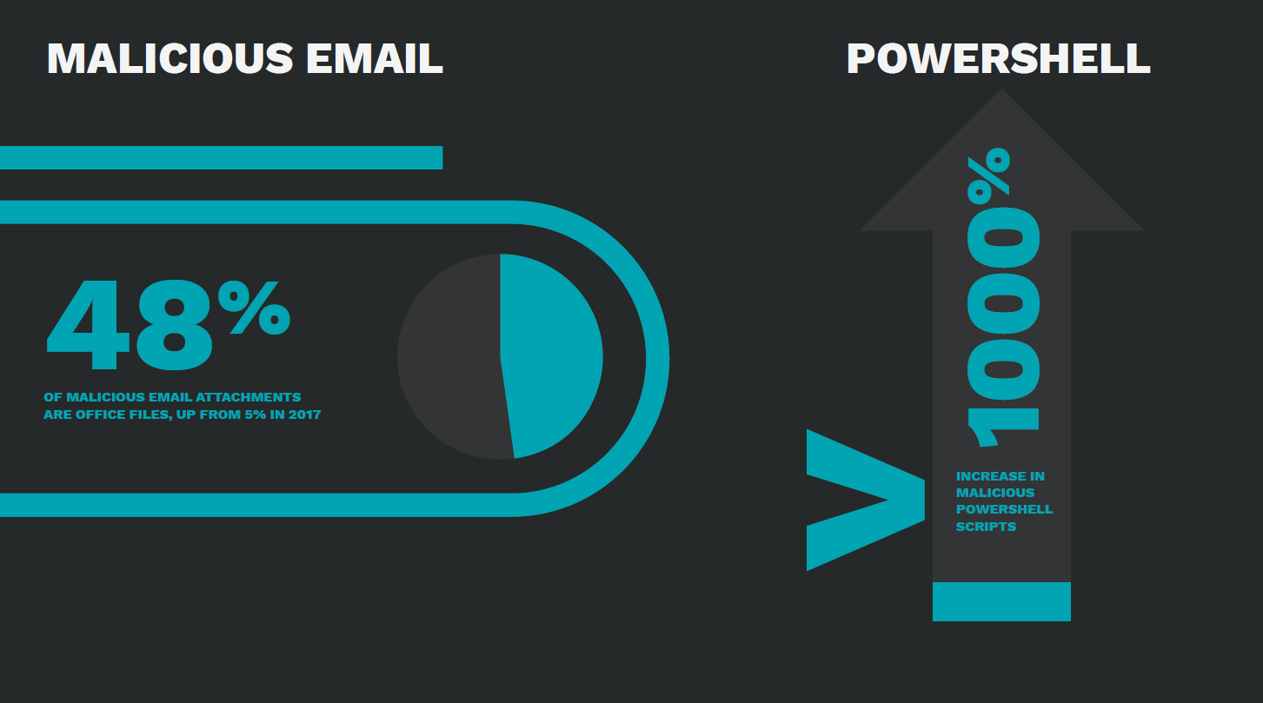
EMAIL DISGUISED AS
NOTIFICATION, SUCH AS
INVOICE OR RECEIPT
ATTACHED OFFICE
FILE CONTAINS
MALICIOUS SCRIPT
OPENING ATTACHMENT
EXECUTES SCRIPT
DOWNLOADS MALWARE

Slide 7
Email: Malware, spam & phishing
Email is one of the prime sources of disruption for end users and organisations.
Unwanted e-mails (Spam)
Propagation of ransomware
Targeted spear-phishing

Slide 8
Business Email Compromise (BEC) Scam
Spear-phishing e-mails
Low tech
Pretending to be the CEO or senior staff
Request large money transfers
A previous report quotes an Australian aerospace company sacking its CEO after losing almost $50 million to BEC scammers.

Slide 9
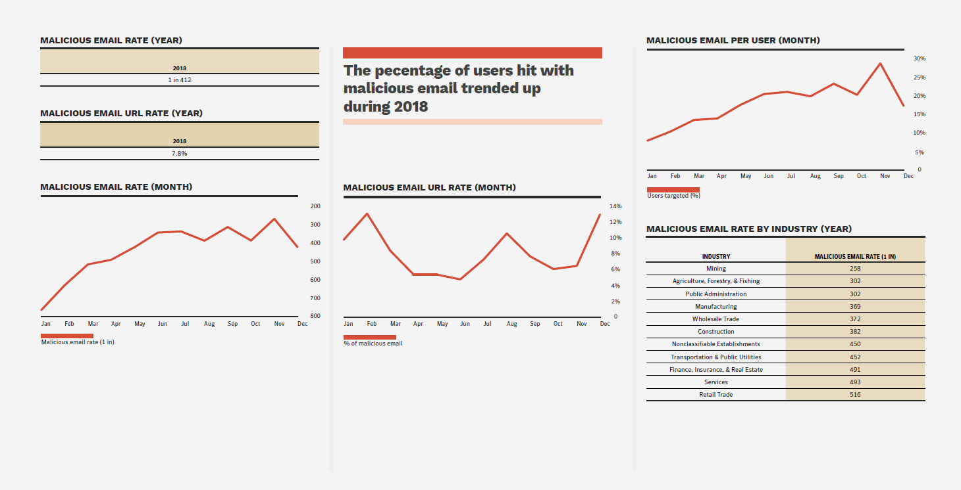

Slide 10
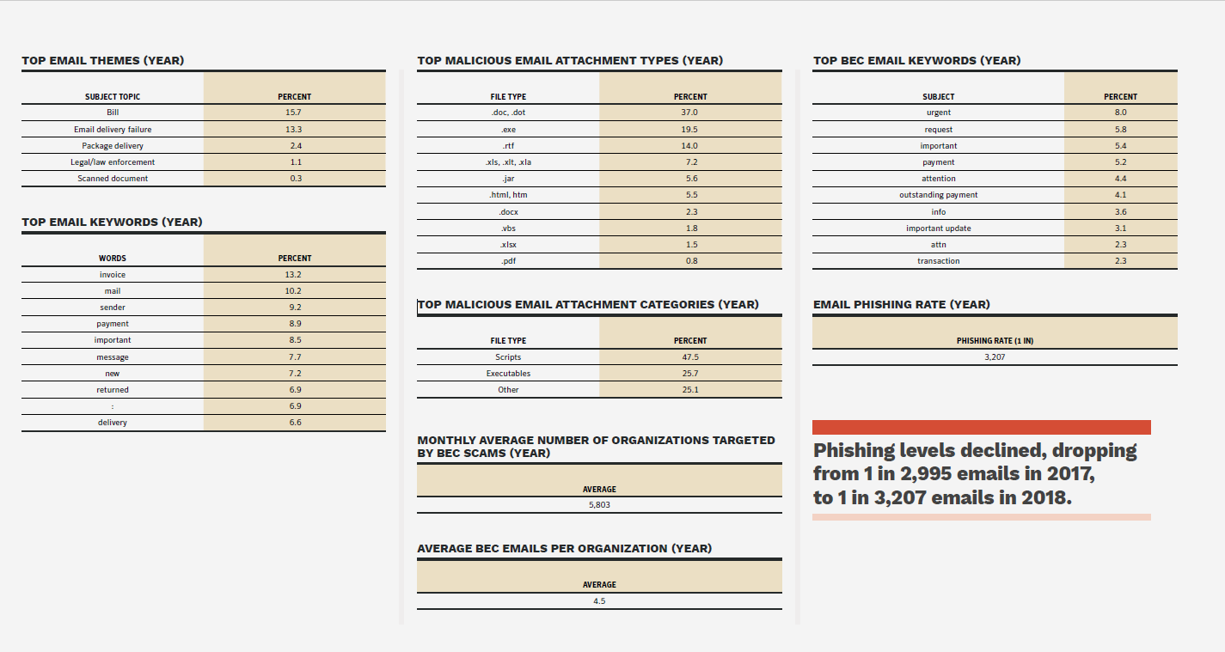

Slide 11
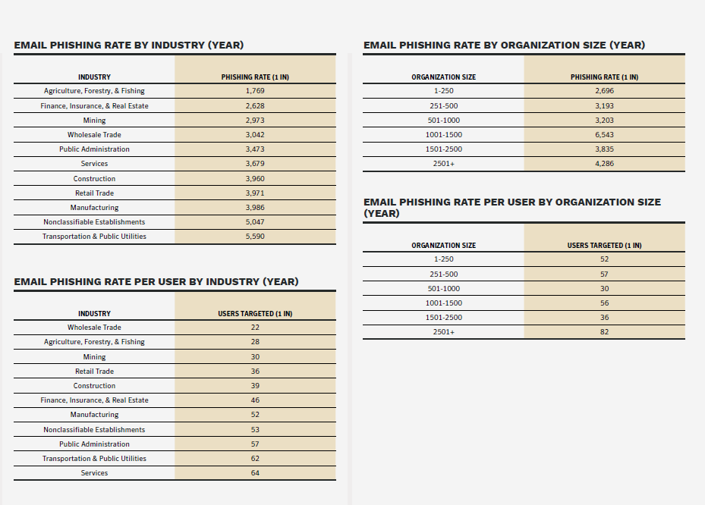

Slide 12
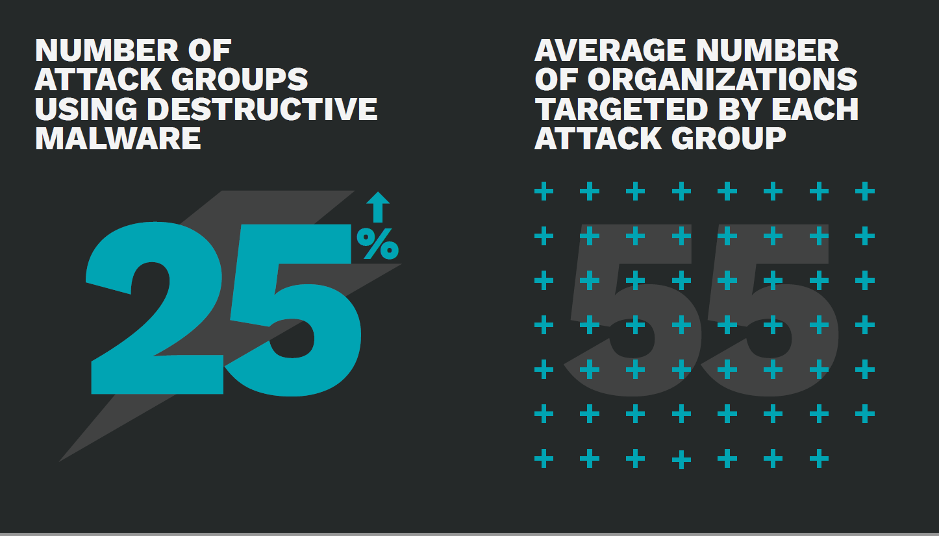

Slide 13
TARGETED ATTACKS
Attacks for subversive purposes
Geopolitical:
Groups affiliated to nations may attempts to use the internet to engage in cyber warfare. Groups may launch attacks against nations, they have grievance against.
Economic espionage (Financial):
Point to point sale systems at a retail organisation (credit/debit) attacks can be sold onto the black market. Actor can also penetrate organisations, compromise accounts etc
Disruption:
To protest the action, decisions or behaviours of an organisation. To serve as distraction while malicious attackers plant something within the network. To gain media attention.

Slide 14
Best Practice

Slide 15
CLOUD
SECURITY CHALLENGES EMERGE ON MULTIPLE FRONTS
From simple misconfiguration issues to vulnerabilities in hardware chips, in 2018 there was a wide range of security challenges that the cloud presents.
Poorly secured cloud databases continued to be a weak point for organizations.
In 2018, S3 buckets emerged as an Achilles heel for organizations, with more than 70 million records stolen or leaked as a result of poor configuration.
This was on the heels of a spate of ransomware attacks against open databases such as MongoDB in 2017, which saw attackers wipe their contents and seek payment in order to restore them.

Slide 16
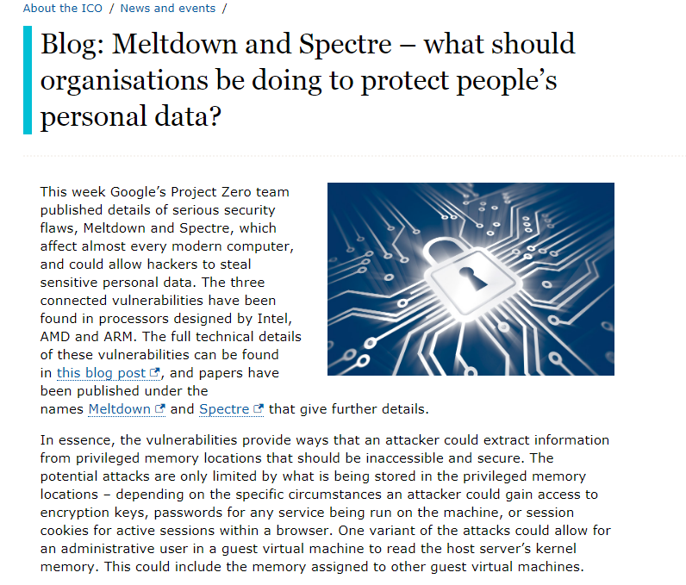
CLOUD
Meltdown and Spectre weren’t isolated cases—several variants of these attacks were subsequently released into the public domain throughout the year. They were also followed up by similar chip-level vulnerabilities such as Speculative
Store Bypass and Foreshadow, or L1 Terminal Fault.
This is likely just the start, as researchers and attackers home in on vulnerabilities at the chip level, and indicates that there are challenging times ahead for the cloud.
https://ico.org.uk/about-the-ico/news-and-events/news-and-blogs/2018/01/blog-meltdown-and-spectre-what-should-organisations-be-doing-to-protect-people-s-personal-data/

Slide 17
IoT
While worms and bots continued to account for the vast majority of Internet of Things (IoT) attacks
2018 saw a new breed of threat emerge as targeted attack actors displayed an interest in IoT as an infection vector.
Routers and connected cameras were the most infected devices and accounted for 75 and 15 percent of the attacks respectively.
It’s unsurprising that routers were the most targeted devices given their accessibility from the internet.
They’re also attractive as they provide an effective jumping-off point for attackers.

Slide 18
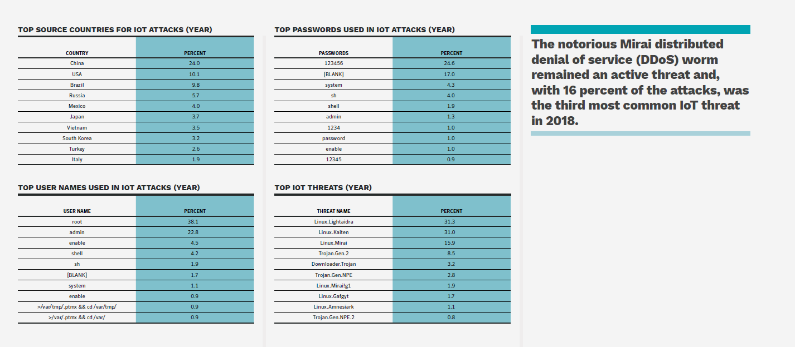
IoT

Slide 19
Mirai
Mirai is malware that turns networked devices running Linux into remotely controlled bots
That can be used as part of a botnet in large-scale network attacks.
It primarily targets online consumer devices such as IP cameras and home routers.
Mirai is primarily for DDoS, however could conceivably lead to compromise of personal information
Passwords
Financial information

Slide 20
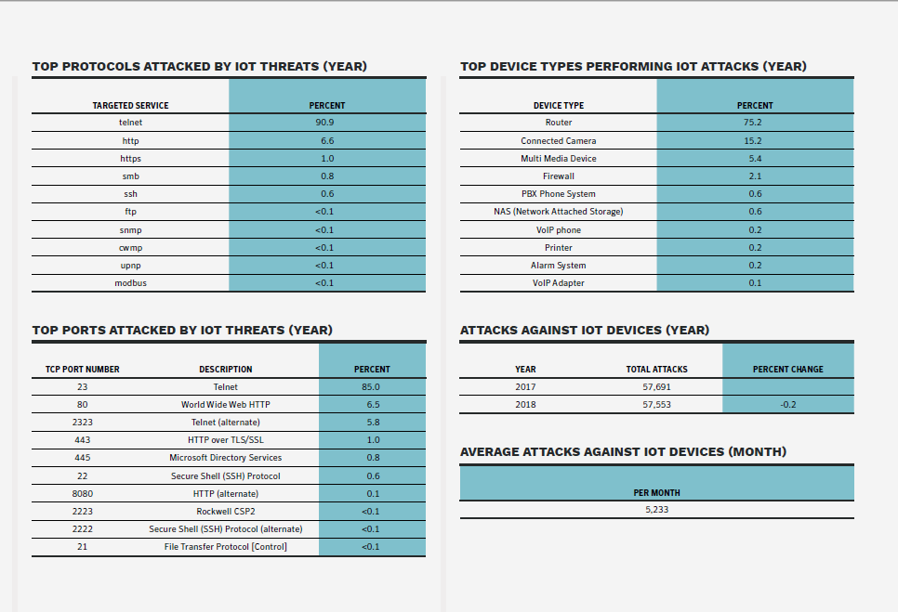
IoT

Slide 21
Best Practice

Slide 22
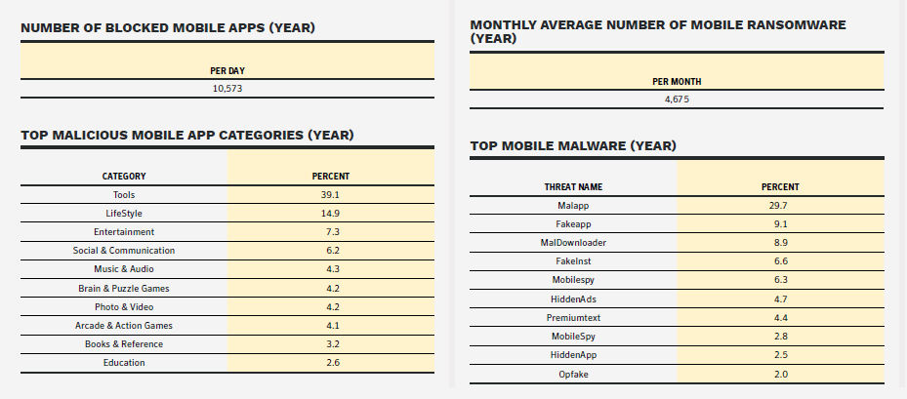
Mobile

Slide 23
Mobile

Slide 24
Web attacks, toolkits & exploiting vulnerabilities
In 2018, 1 in 10 URLs analyzed were identified as being malicious, up from 1 in 16 in 2017.
Despite a drop off in exploit kit activity, overall web attacks on endpoints increased by 56 percent in 2018.
By December, Symantec was blocking more than 1.3 million unique web attacks on endpoint machines every day.

Slide 25
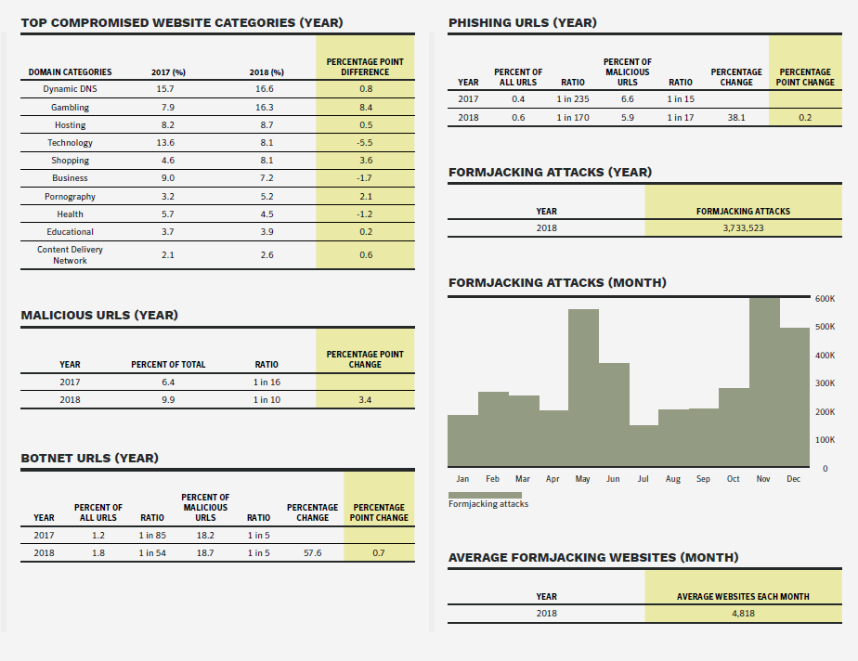
Web

Slide 27
Cyber Crime & the underground economy
More high profile victims
Much bigger financial gain

Slide 28
So what is the motivation for Cyber Criminals?
Money, Yes obviously… But how much money?

Slide 29
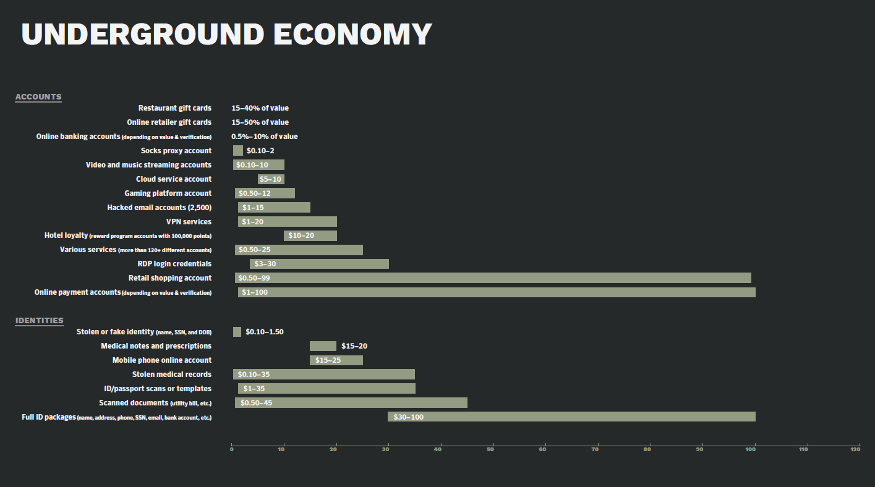

Slide 30
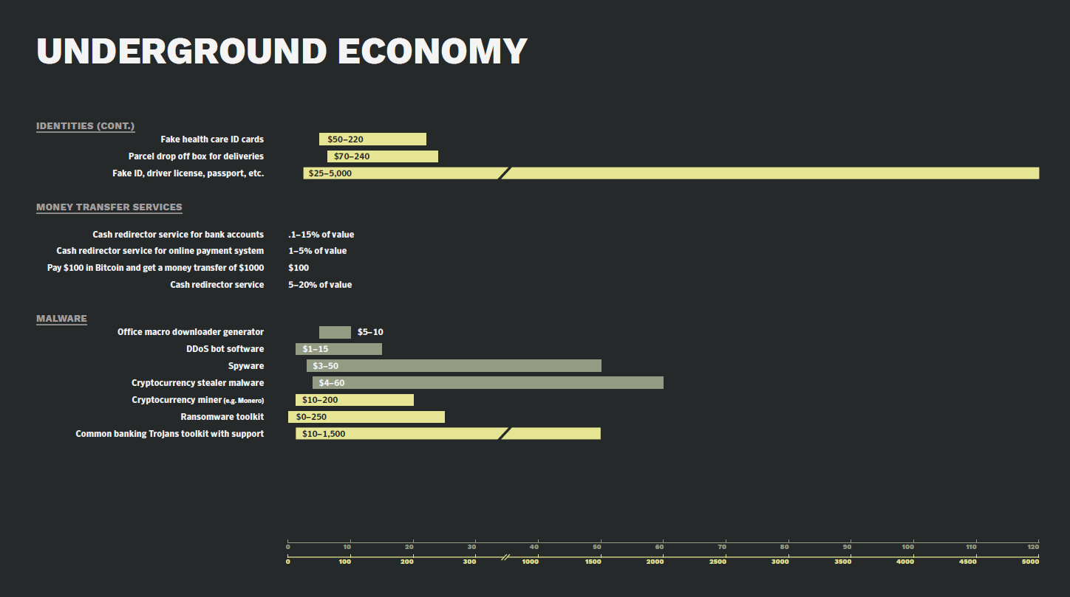

Slide 31
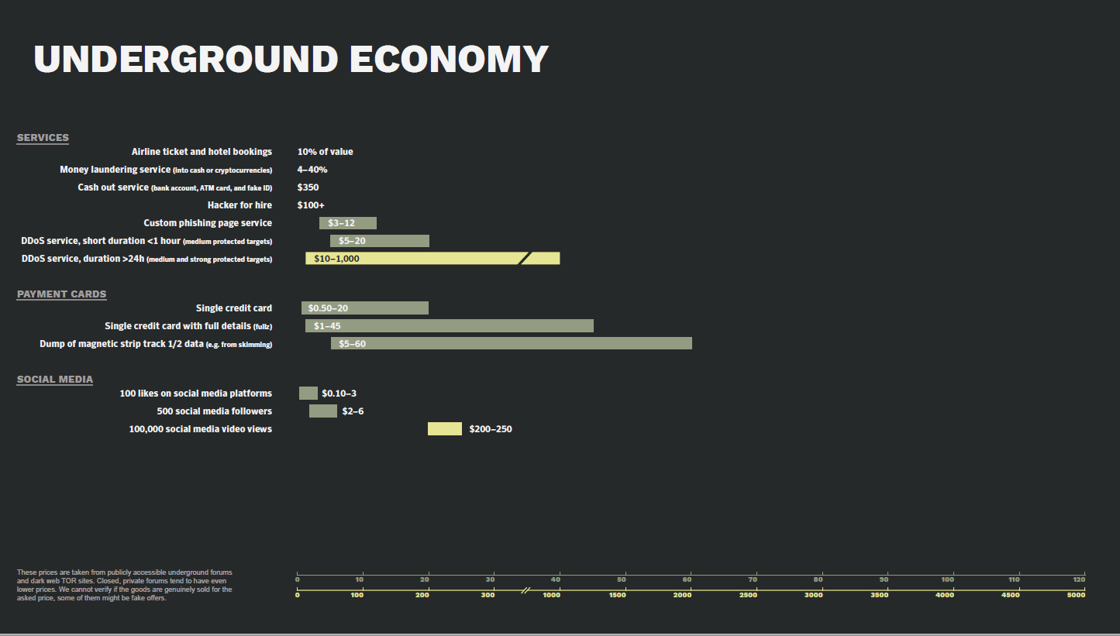

Slide 32
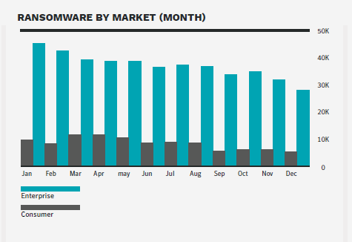
Ransomware: Extorting Business & Consumers
The overall number of ransomware infections fell, dropping by more than 20 percent year-on-year.
However, enterprise detections bucked the trend, increasing by 12 percent, demonstrating that ransomware continues to be a problem for enterprises.

Slide 33
WannaCry
Double Pulsar and EternalBlue both believed to have been developed by US National Security Agency
The WannaCry ransomware attack was a May 2017 worldwide cyber attack by the WannaCry ransomware cryptoworm.
It targeted computers running the Microsoft Windows operating system by encrypting data and demanding ransom payments in the Bitcoins.
The "payload" works in the same fashion as most modern ransomware
it finds and encrypts a range of data files, then displays a "ransom note" informing the user and demanding a payment in bitcoin.
It is considered a network worm because it also includes a transport mechanism to automatically spread itself.
This transport code scans for vulnerable systems, then uses the EternalBlue exploit to gain access, and the DoublePulsar tool to install and execute a copy of itself.

Slide 34
What else could go wrong….

Slide 35
British Airways
On Monday 8th July, the UK's data protection authority, the Information Commissioner’s Office (the ICO), announced its intention to fine British Airways in the amount of £183 million
The fine relates to a cyber incident involving user traffic to the British Airways website being diverted to a fraudulent site.
Through this false site, customer details were allegedly harvested by attackers.
The ICO’s investigation found that a variety of information of approximately 500,000 customers was compromised in this incident, including log in, payment card, and travel booking details as well name and address information.

Slide 36
Marriot Hotels
Following an extensive investigation the ICO has issued a notice of its intention to fine Marriott International £99,200,396 for infringements of the General Data Protection Regulation (GDPR).
The proposed fine relates to a cyber incident which was notified to the ICO by Marriott in November 2018.
A variety of personal data contained in approximately 339 million guest records globally were exposed by the incident, of which around 30 million related to residents of 31 countries in the European Economic Area (EEA).
Seven million related to UK residents.

Slide 37

Questions/Answers/ Discussion/Comparison

